Slide 1



INTRODUCTION TO RASPBERRY PI
MANOJKUMAR
Manoj@ELECTROLANCE.COM
Notes:
How many of you know what's a RPI ?

Slide 2
HISTORY
Born on Feb 2012, by the Raspberry Pi Foundation.
Aimed to promote and teach Computer Science in schools around UK.
Became popular in short time due to cost($25-35) and open-source community. Sold more than the targeted market for the first model of RPI.
Notes:
http://novadigitalmedia.com/history-raspberry-pi/

Slide 3
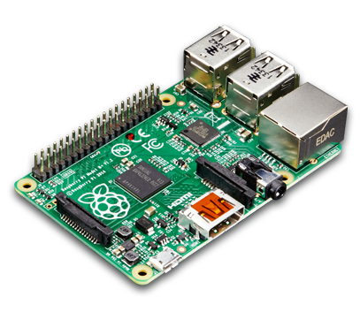

What is raspberry pi ?
A credit card sized microcomputer board.
Classified as Single Board Computer SBC.
Official OS, Raspbian a Linux Distro.

Slide 4
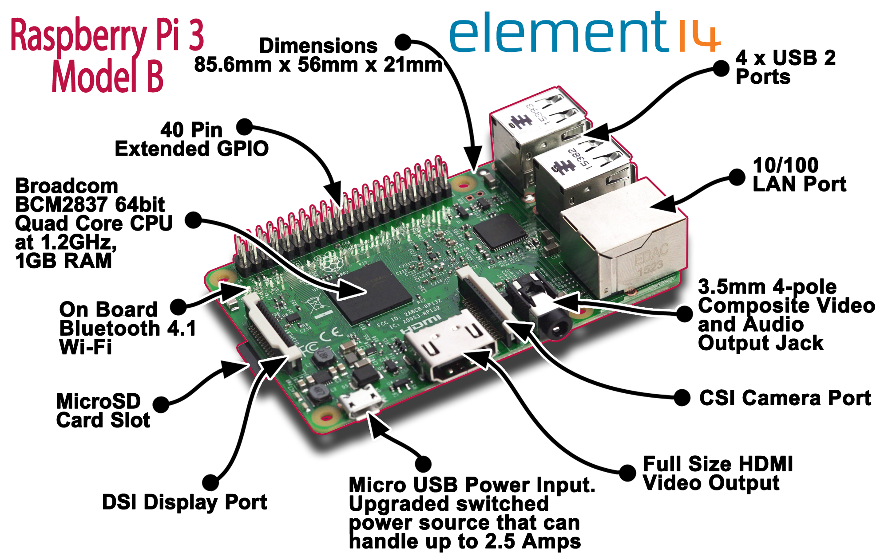
Overview of rpi physical layout

Slide 5
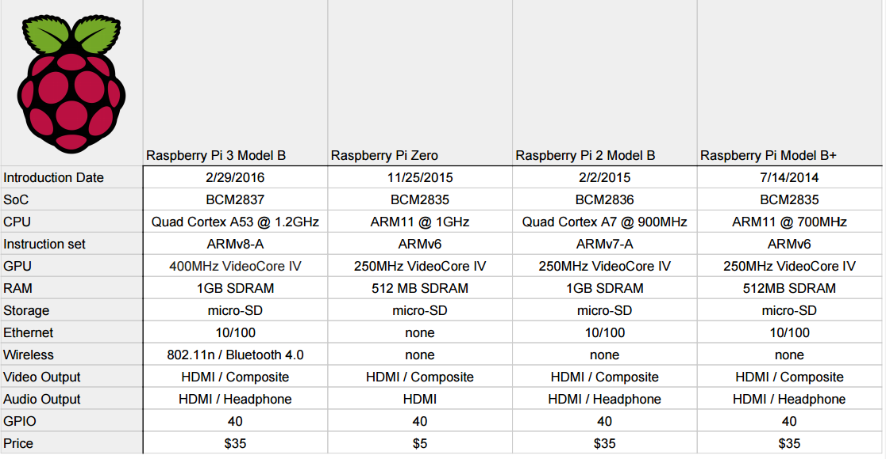
Raspberry pi hardware specifications

Slide 6

Learning programming with RPI
What is programming ?

Slide 7
Why raspberry pi as a coding platform
Almost all widely-use programming language are able to execute on RPI, Raspbian Linux OS. To name a few : Python, C, C++, JavaScript and Scratch.
Great community support from Raspberry Pi official forum, Stack Overflow.
Tonnes of example of completed project as Reference.
Experience the Linux OS and all is open-source.
Most importantly it’s relevant to industry standard, It’s not a toy
Nothing to worry of things going wrong. Learn with Guilt Free. Focus on learning not to worry on mistakes.

Slide 8
Learning electronics with rpi
Exposed GPIO pins to connect to external electronics components.
GPIO = General-purpose input/output (GPIO)
Inputs can be Button switch, Sensor Signals.
Output = Sound, LED(Lights), Motors, and Relays.
Able to automate many daily task and build DIY of existing things. Eg : Door Alarm, RC Toy Car etc.

Slide 9
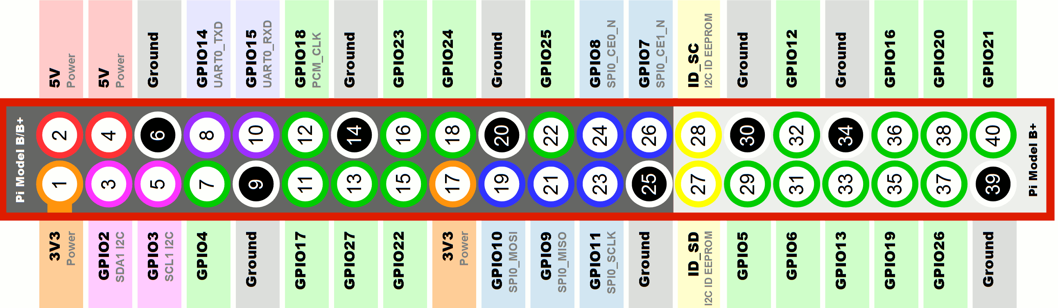
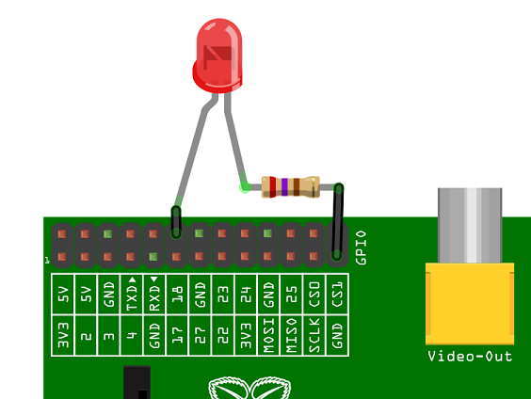
A look at GPIO

Slide 10
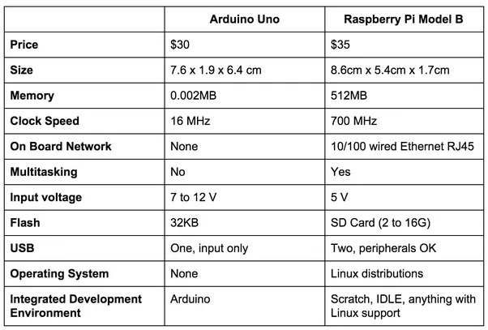
Raspberry pi vs Arduino

Slide 11
Demo projects
- SiriControl Voice Lamp.
- IP CAMERA.
- C programming.
- Node-red(If time permits)

Slide 12
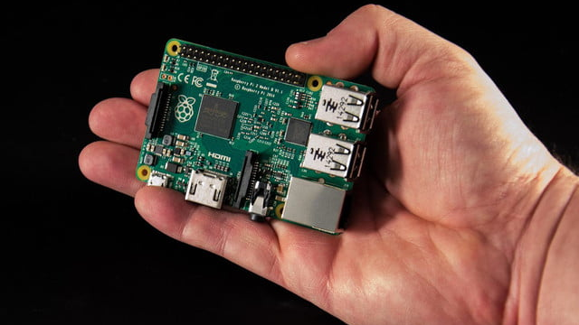
HANDS ON SESSION
Prerequisite :
Laptop with sd card reader/ext reader
Raspberry pi + sd card
All files copied from the usb flash drive
A lan cable, micro-usb power cable

Slide 13
Raspbian os setup
COPY THE FOLDER FROM THE FLASH DRIVE.
INSTALL THE .win32diskimager.
EXTRACT THE "02.2017-11-29-raspbian-stretch"
ZIP FILE

Slide 14
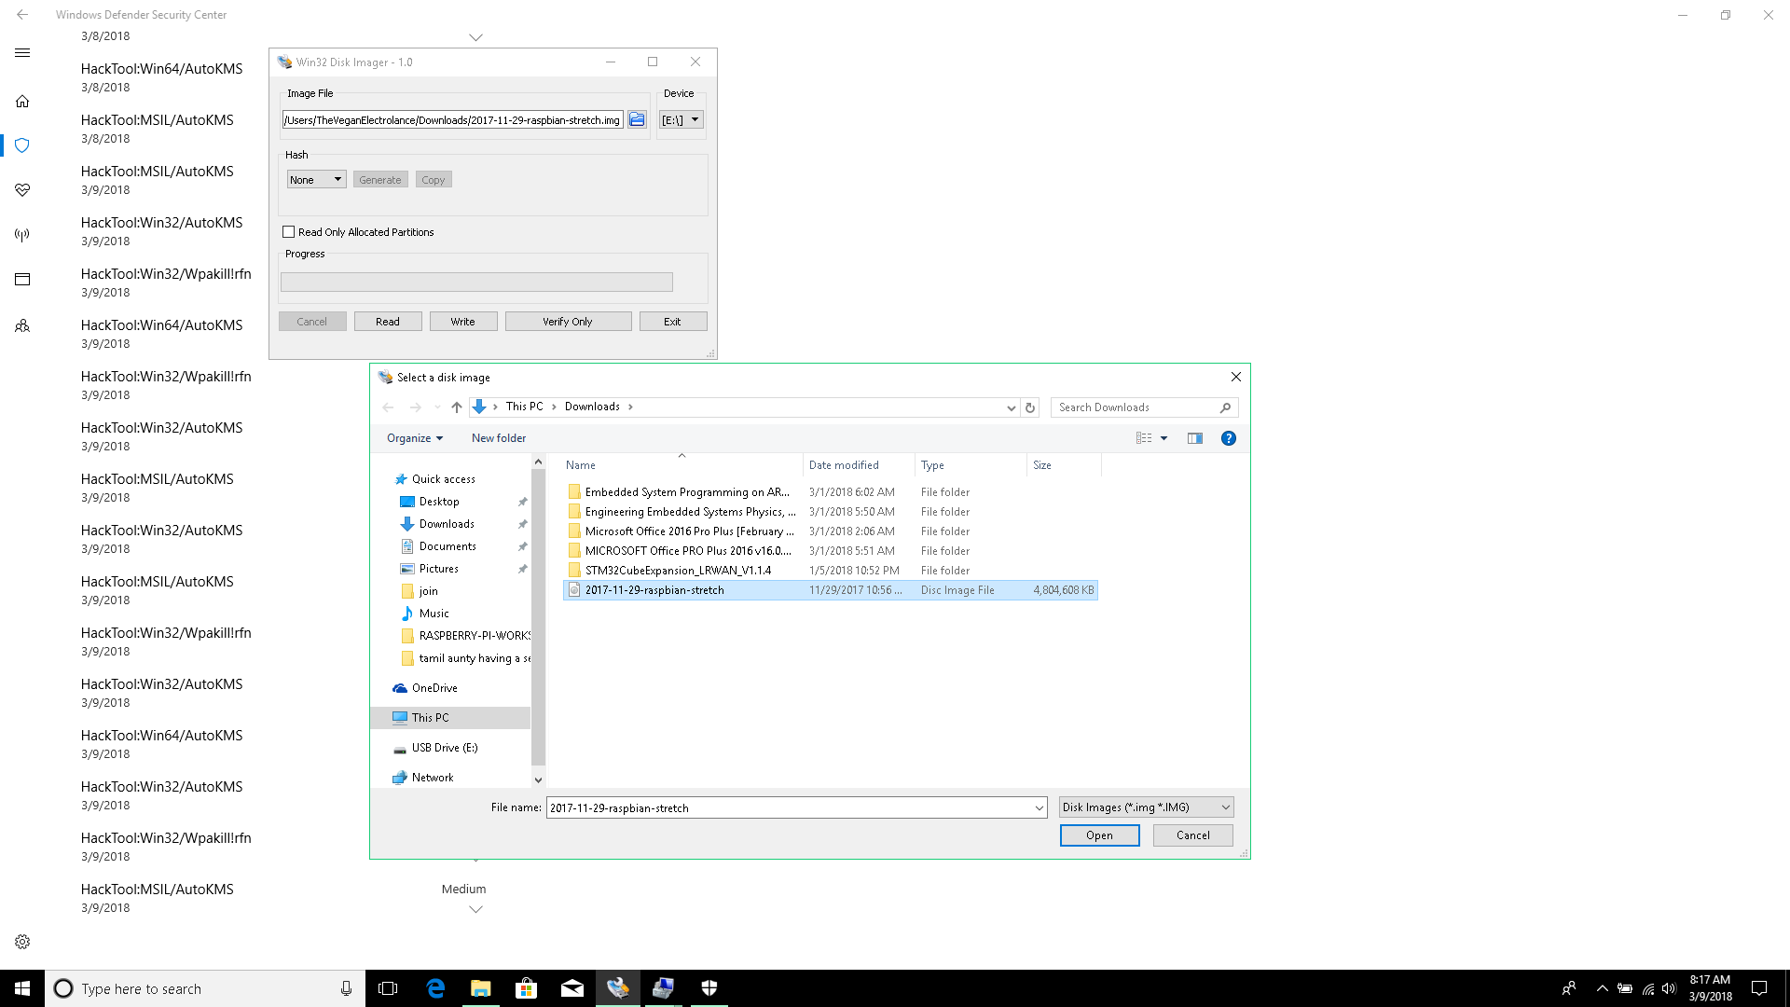
Installing the os to sd card
1. Click the folder icon.
SD card is the bootable option drive for RPI.
2. Select the extracted file from zip

Slide 15
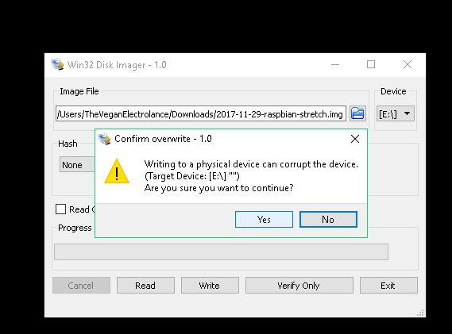
Writing the os to the sd card
4. Yes
Attention : Make sure you selected the correct Drive path for the targeted Device.
Wait till the bar completed.
3. Click on Write

Slide 16
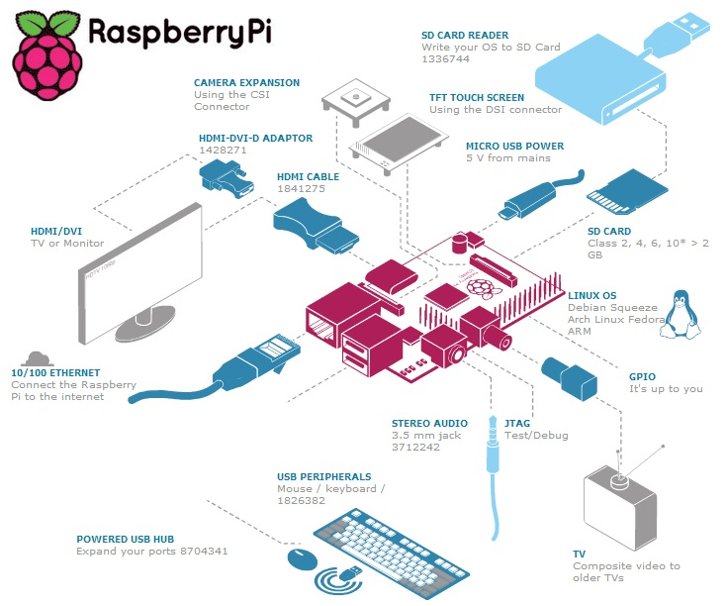
Raspberry pi for general usage
Using like everyday desktop system.
A short DEMO.

Slide 17
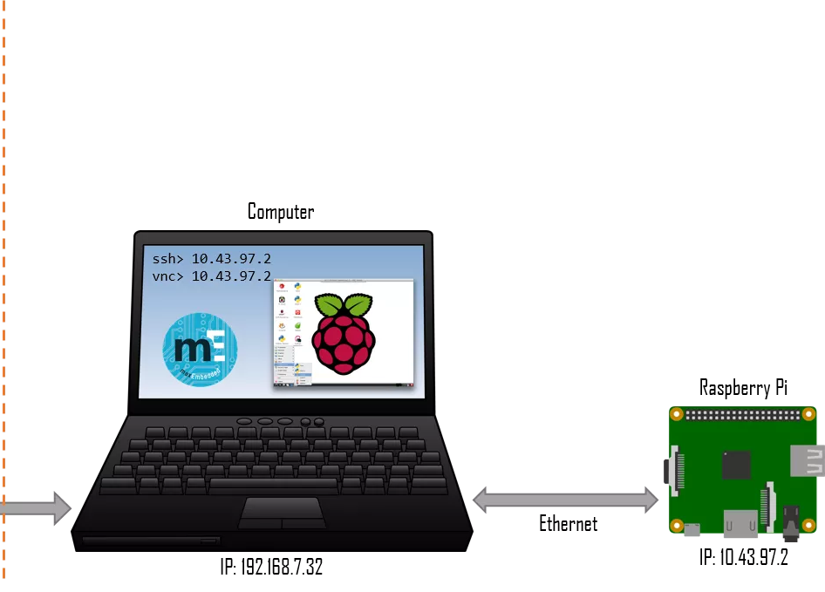
Learning what is headless boot up
Remote access to our Raspberry Pi

Slide 18
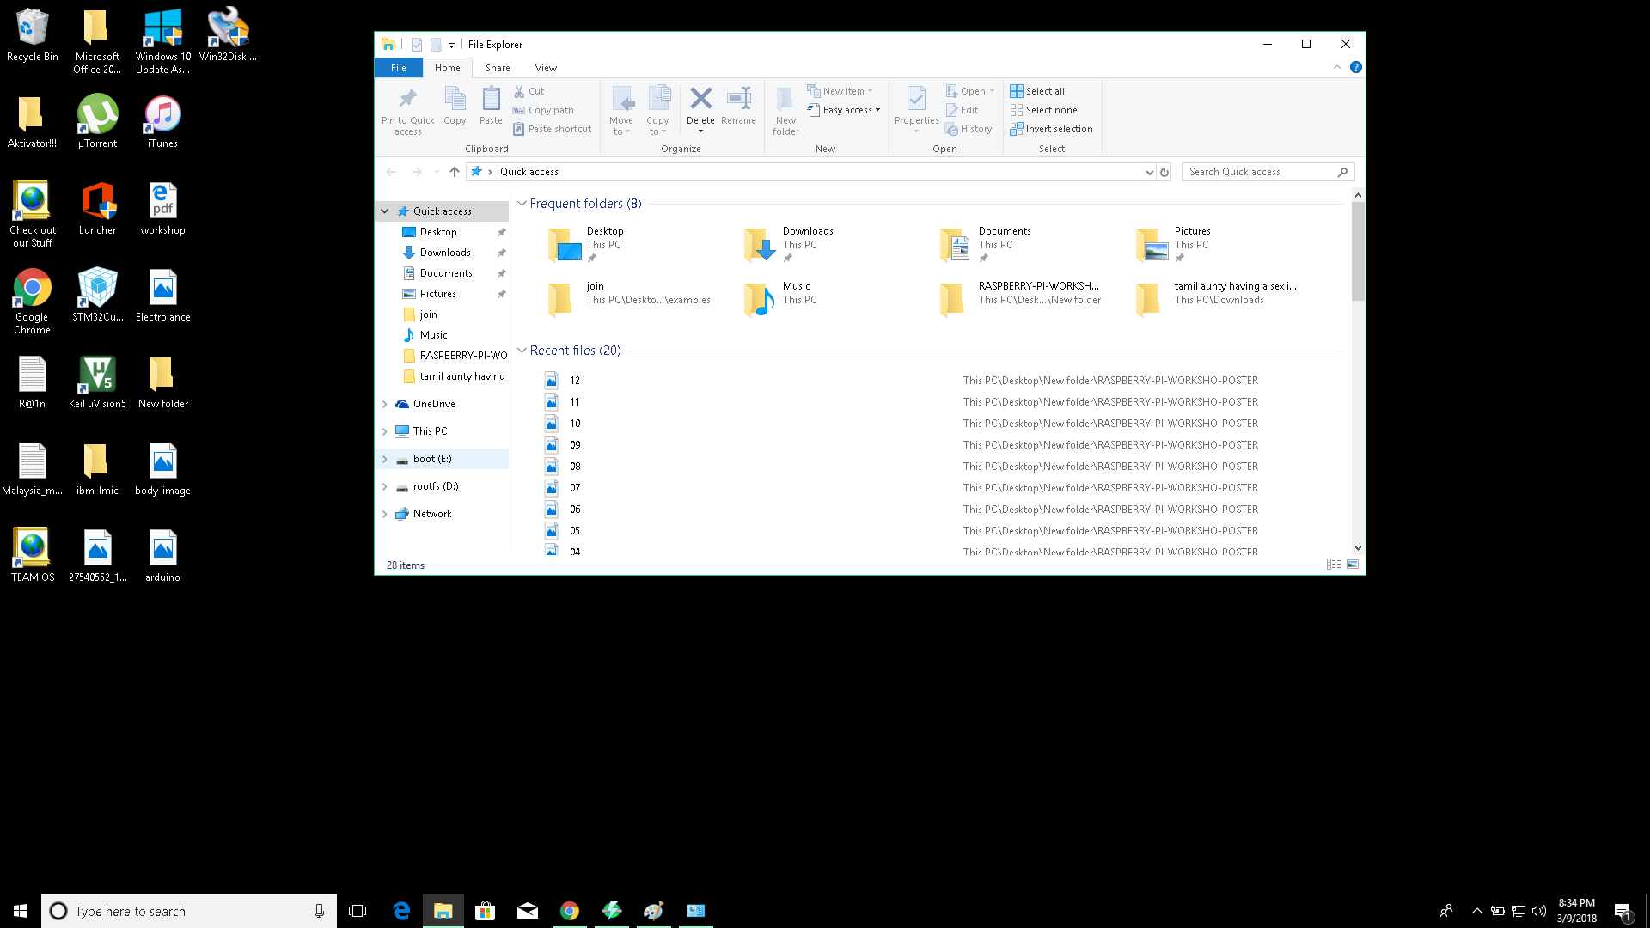
Setup ssh on RPI to grant access to terminal
1. Locate boot drive
2. Click on the drive.

Slide 19
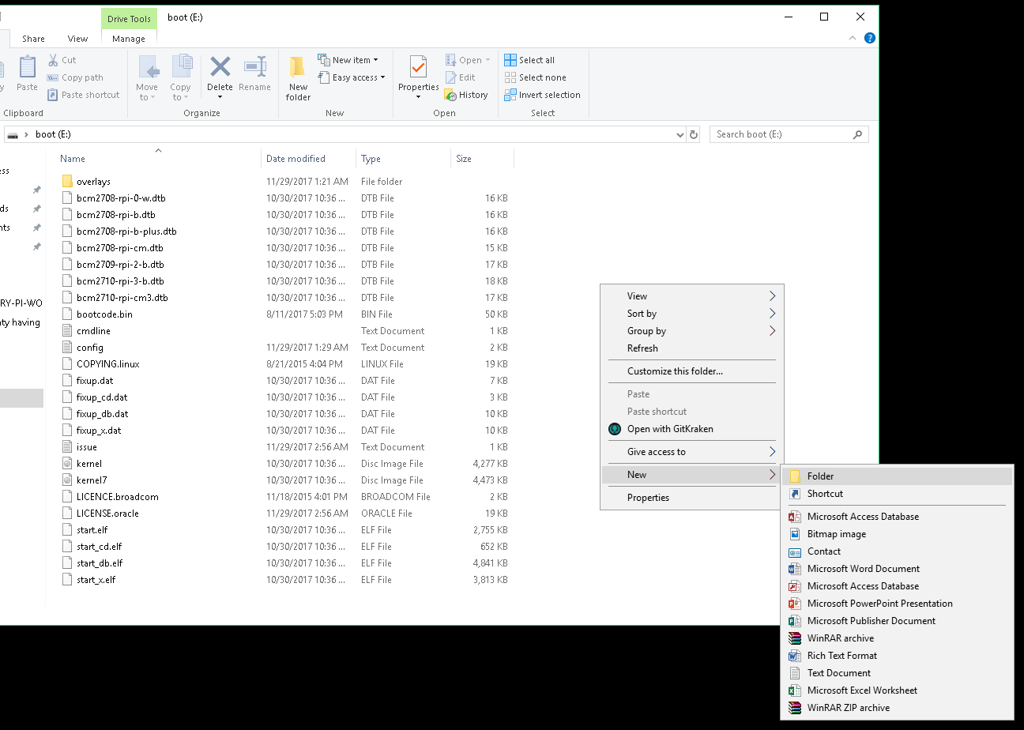
3 . Make sure it's in boot drive
4. Create a folder named ssh

Slide 20
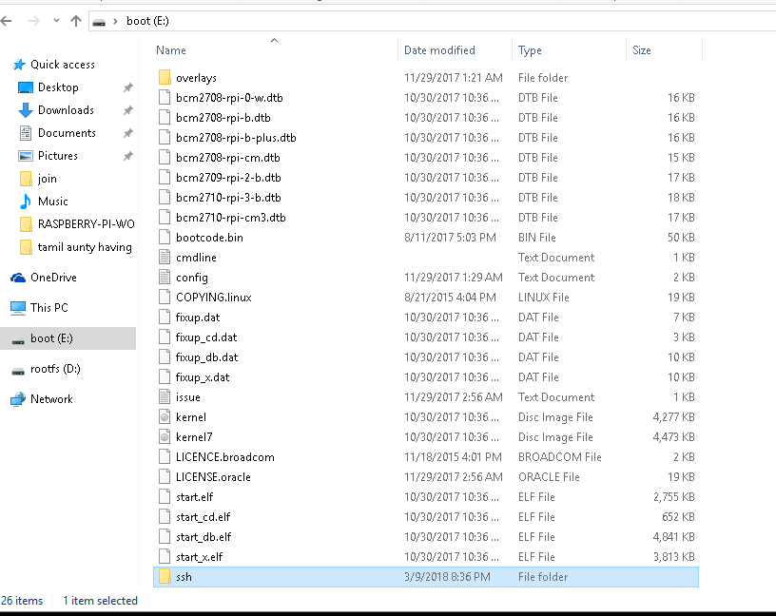
The ssh folder should be inside.

Slide 21
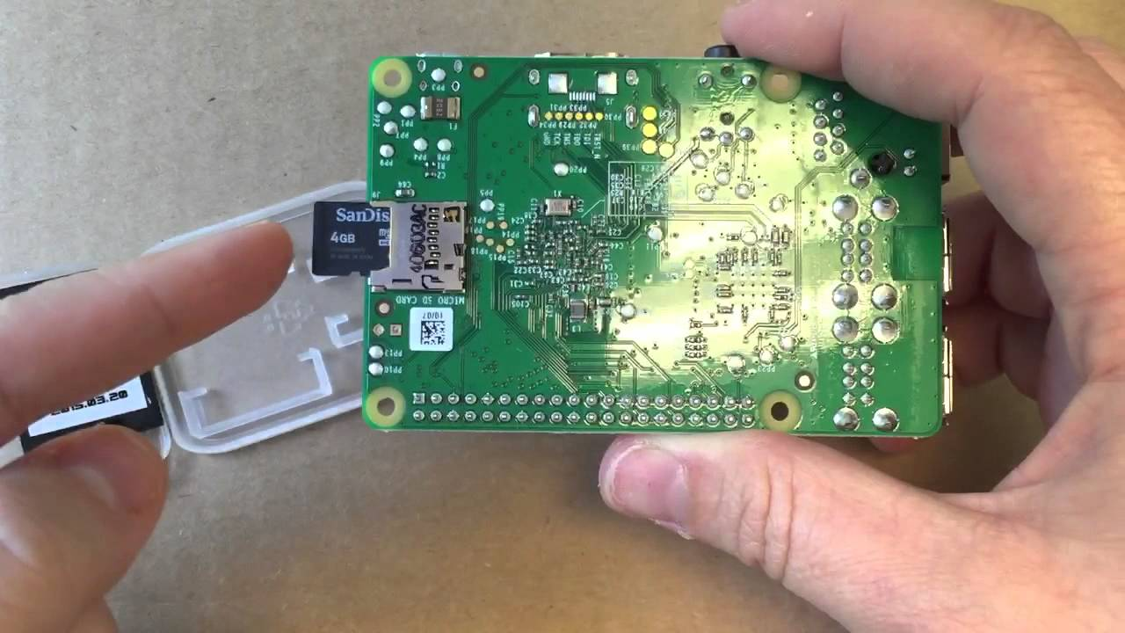
5. Unplug the sd card from the reader
6. Insert the Micro SD Card into the Raspberry PI

Slide 22
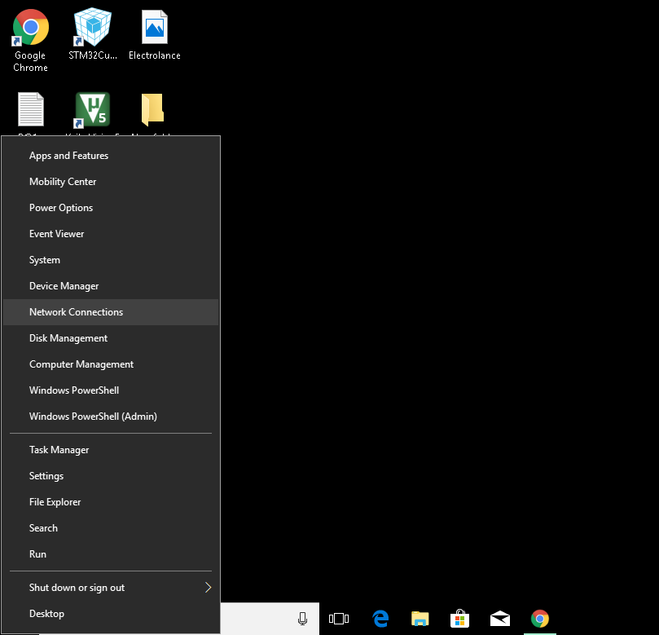
Configuring the Ethernet Connection for RPI.
Press Windows Key + X
A side quick menu should appear
Click on Network Connections

Slide 23
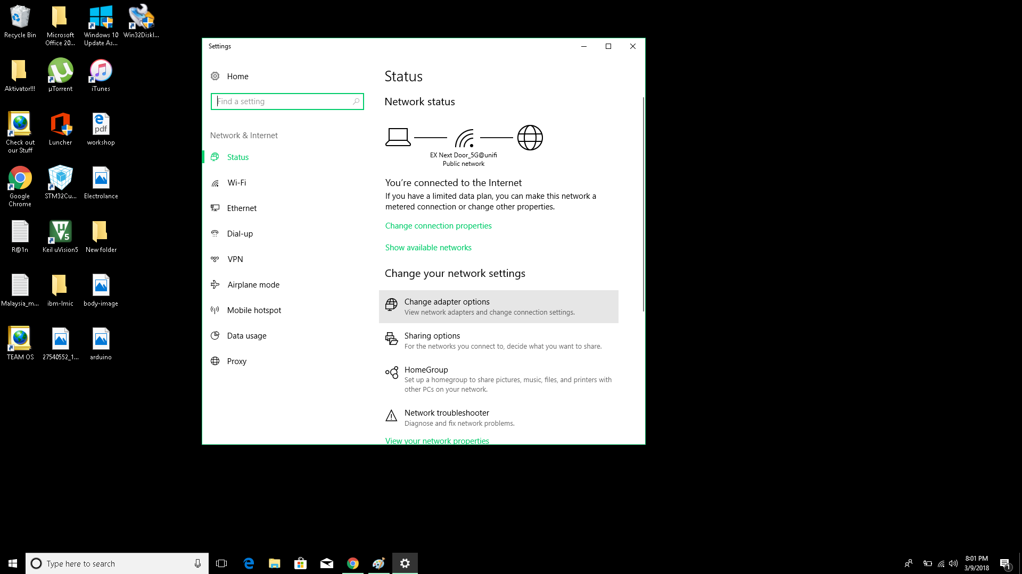
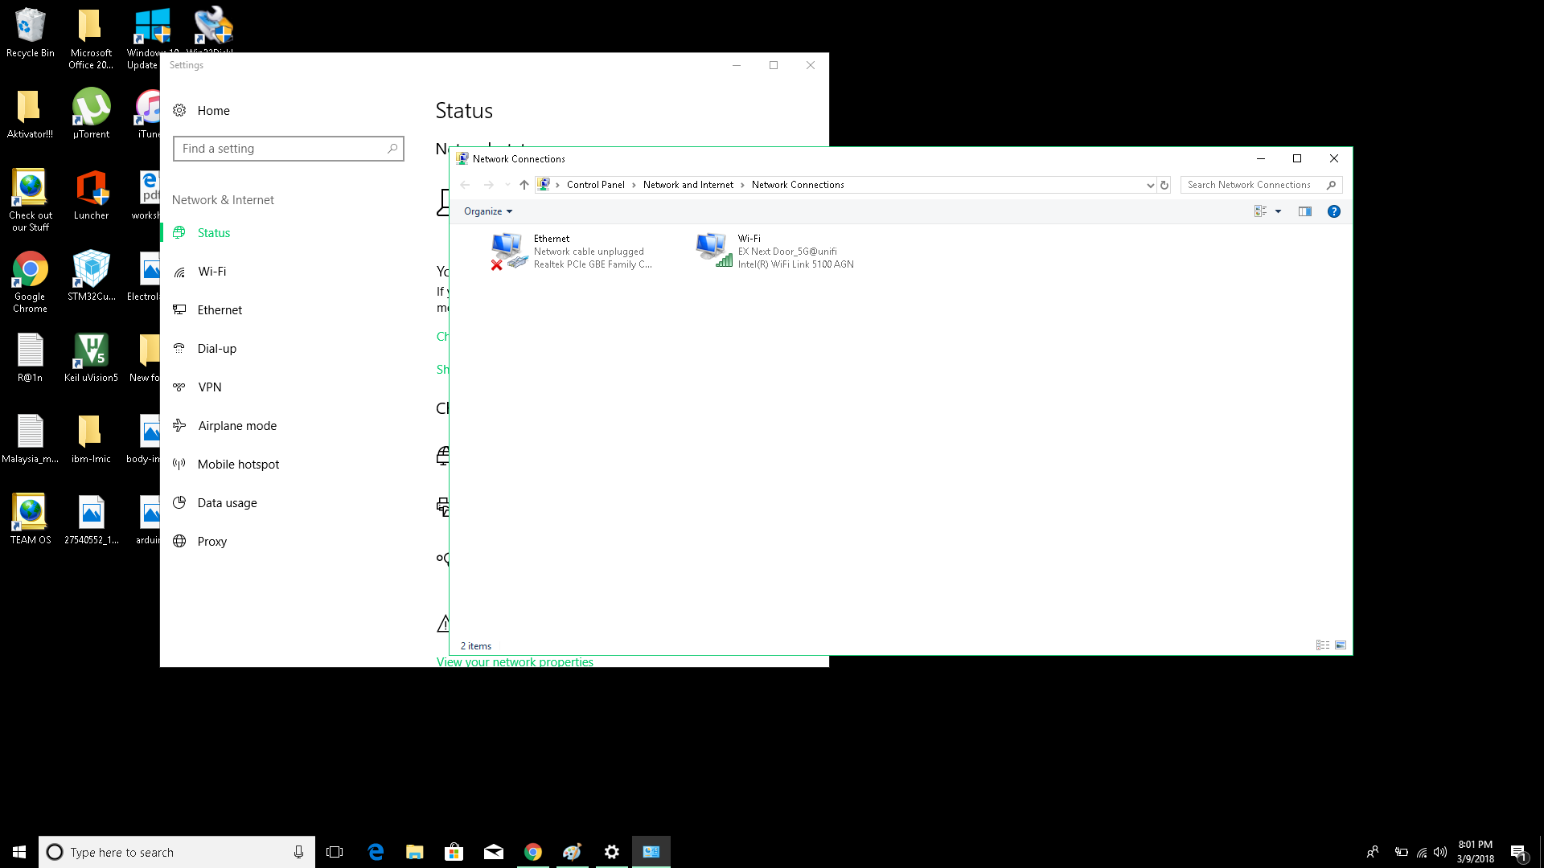
4. Click on Change Adapter Options.
6. Should have arrived to this window

Slide 24
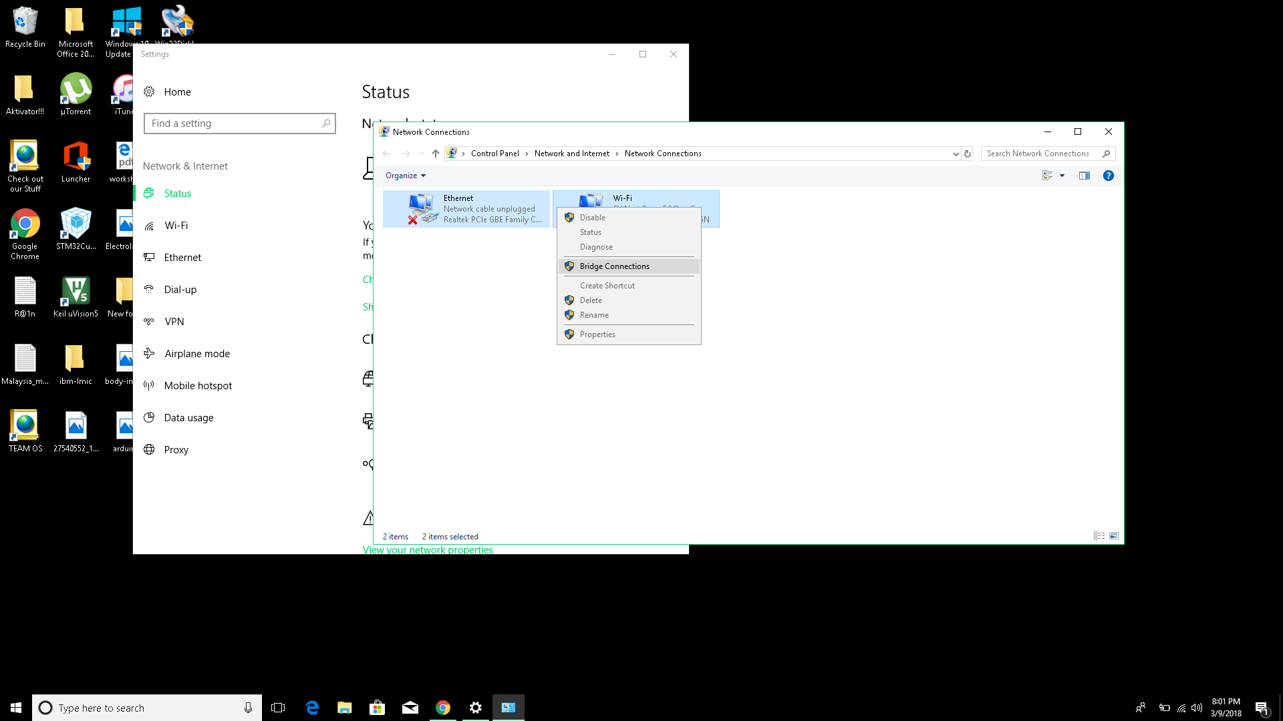
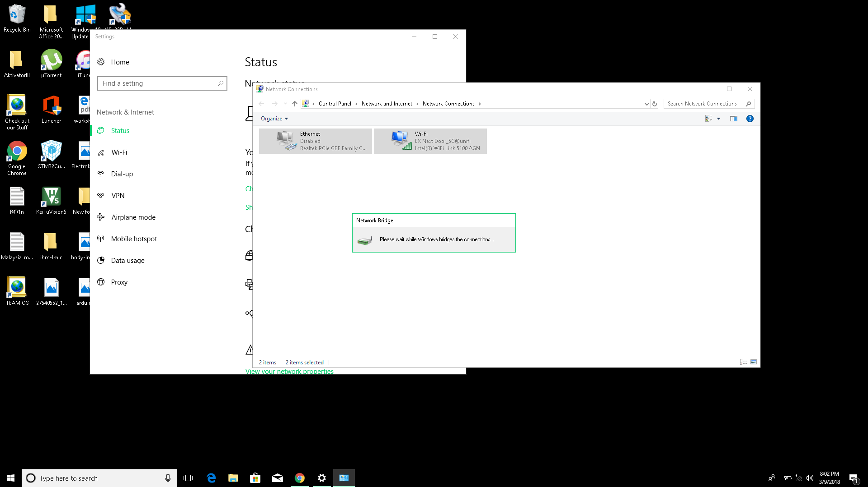
7.Select your wifi connection and Ethernet(LAN) and followed by a right-click on mouse.
8. Click Bridge Connections
9. Should see this window after step 8.

Slide 25
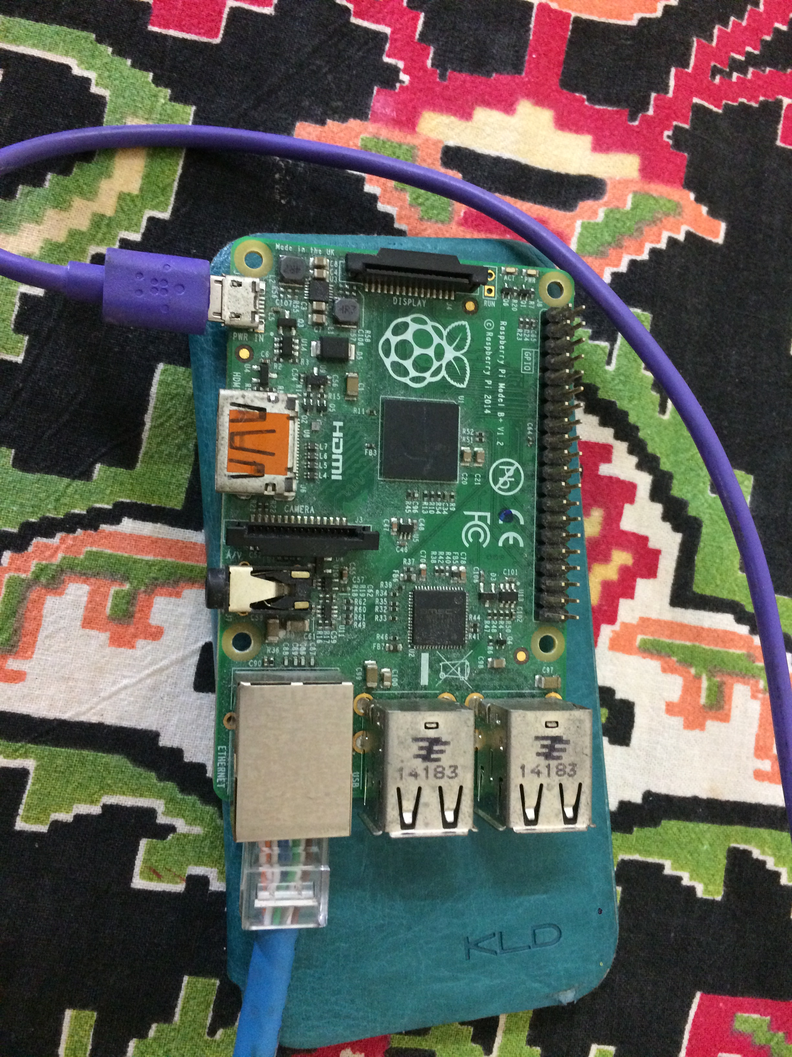
Connecting to rpi vis SSH Terminal
Power on your raspberry pi by plugging the micro-usb cable and LAN cable
V
Connect the LAN Cable to your laptop
Plug the micro-usb cable to your laptop USB ports

Slide 26
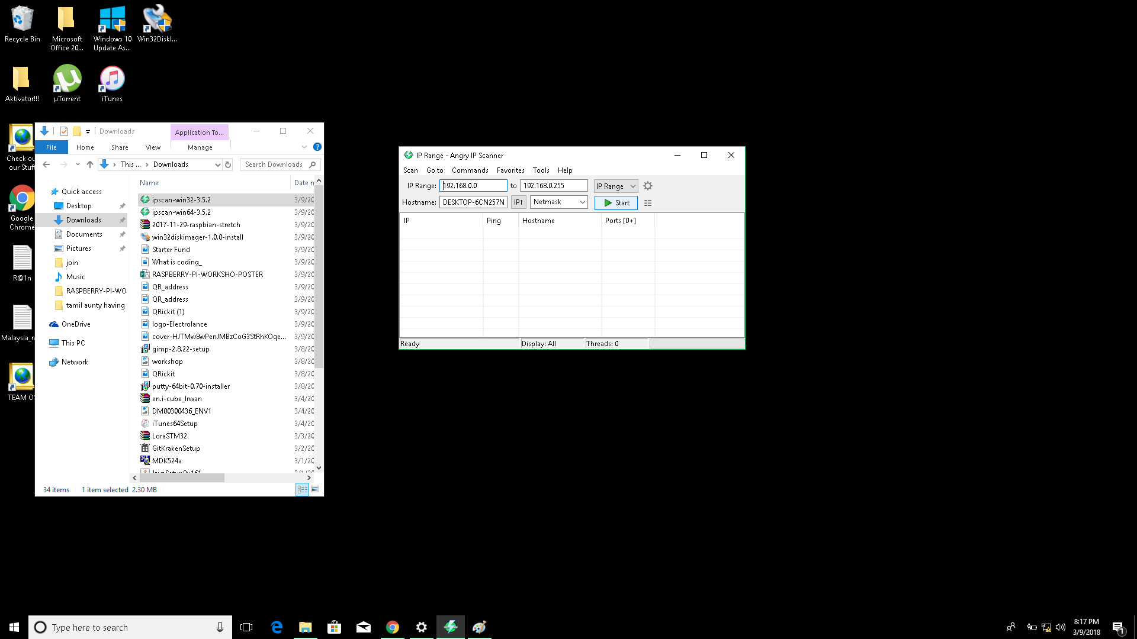
Locating rPI’s Ip-address
2. Run the ipscan software by clicking it
3. The software should launch and show up as in the image pointed on the right.
4. Click start to start searching all alive hosts.

Slide 27
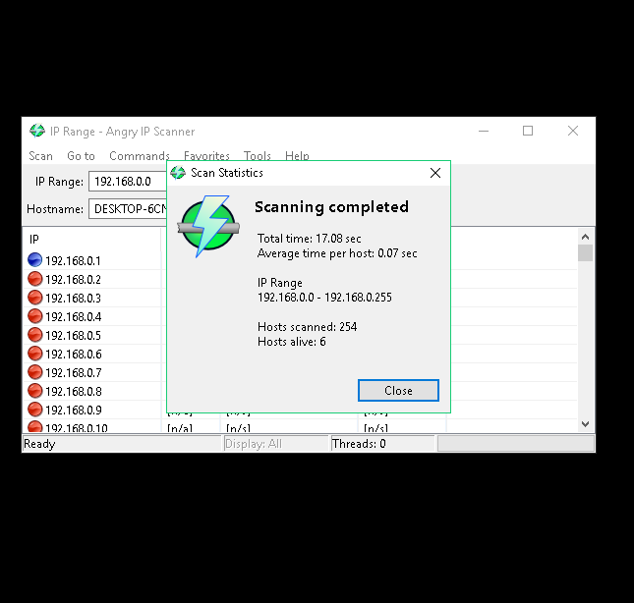
5. After scanning is completed A window will pop-up, Click close.

Slide 28
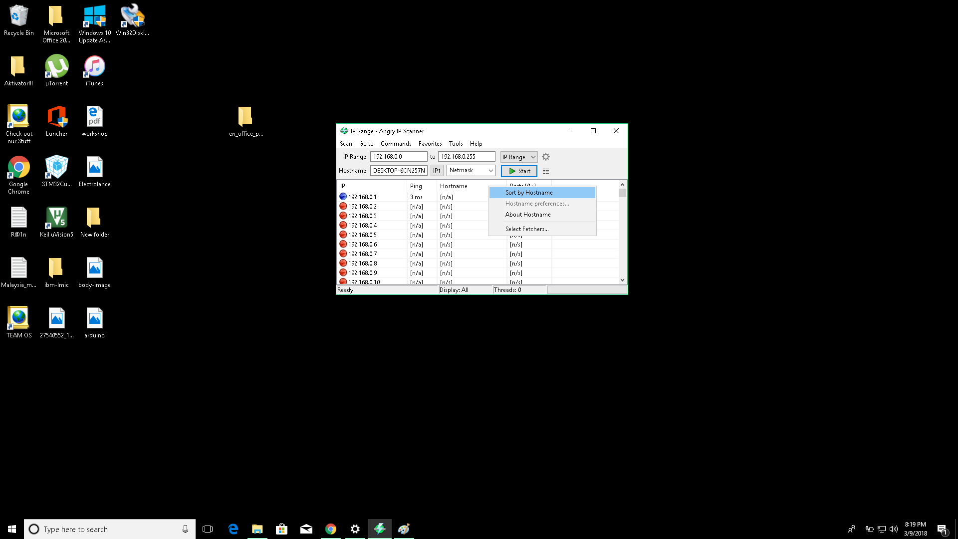
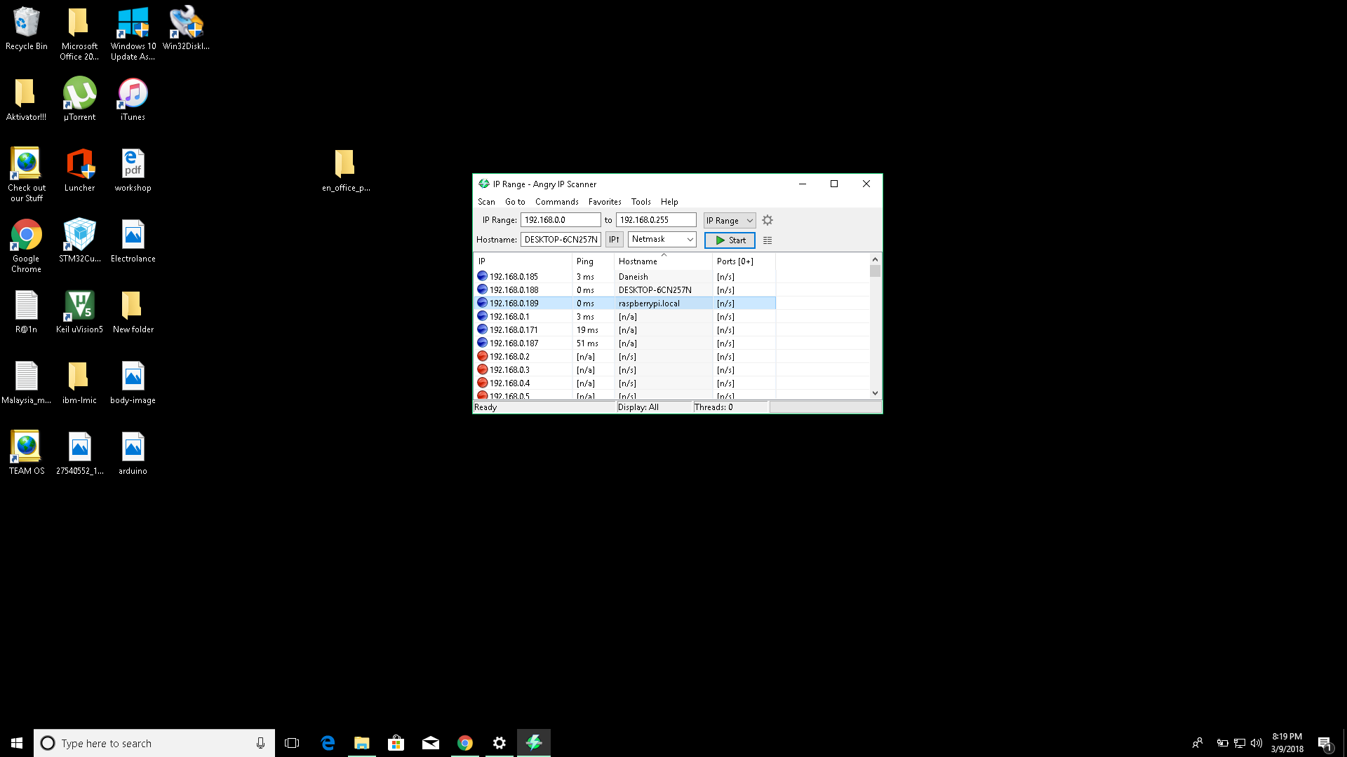
6. Right click on Hostname column and select Sort by Hostname.
7. After sort, look for the host name “raspberrypi.local” and select the row.

Slide 29
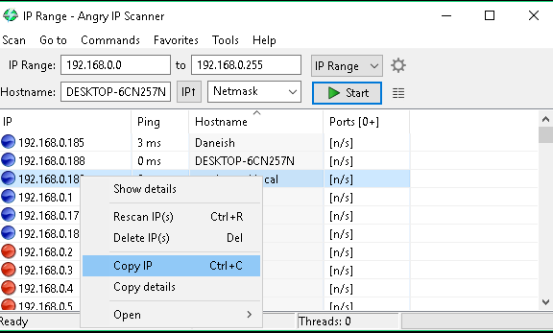
7. Right click on the selected row on the IP column and followed by Copy IP.

Slide 30
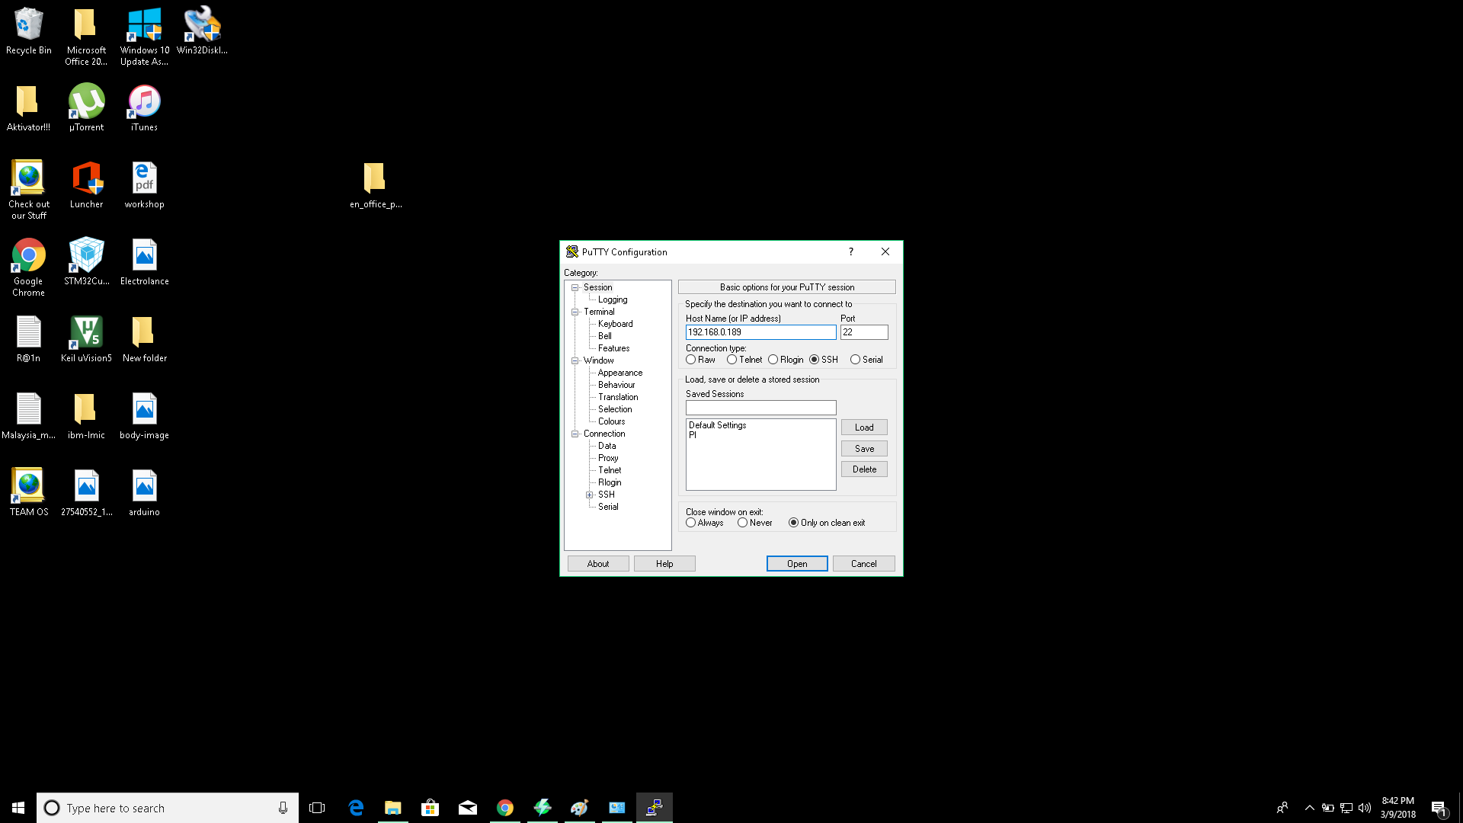
8. Install Putty.
9. Open putty after installation completed.
10. Paste copied Ip to “Host Name (or IP Address)” field and click open
1
2

Slide 31
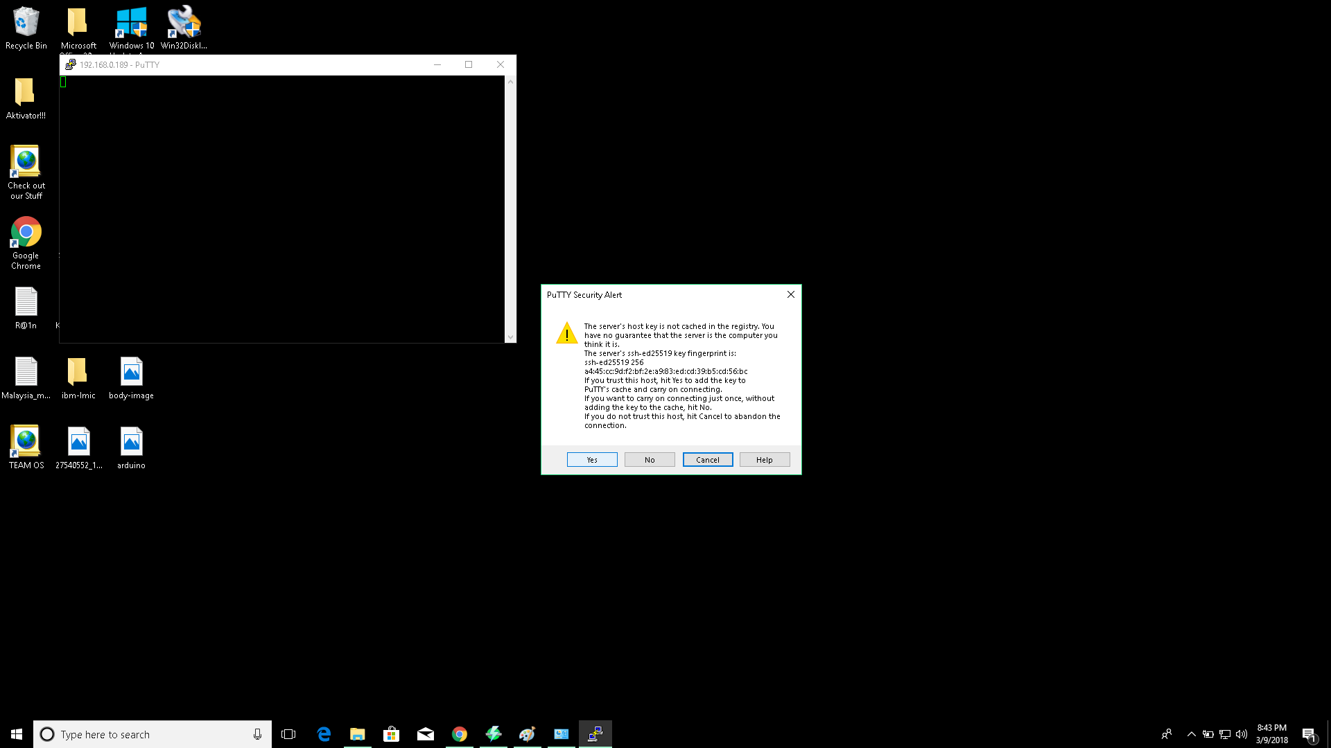
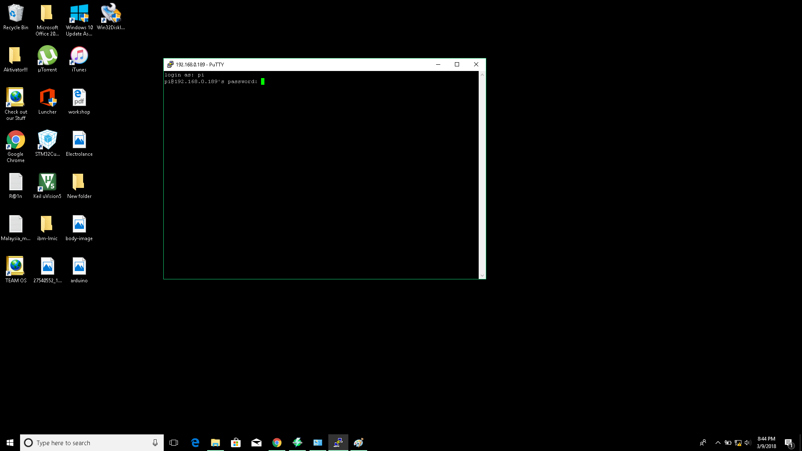
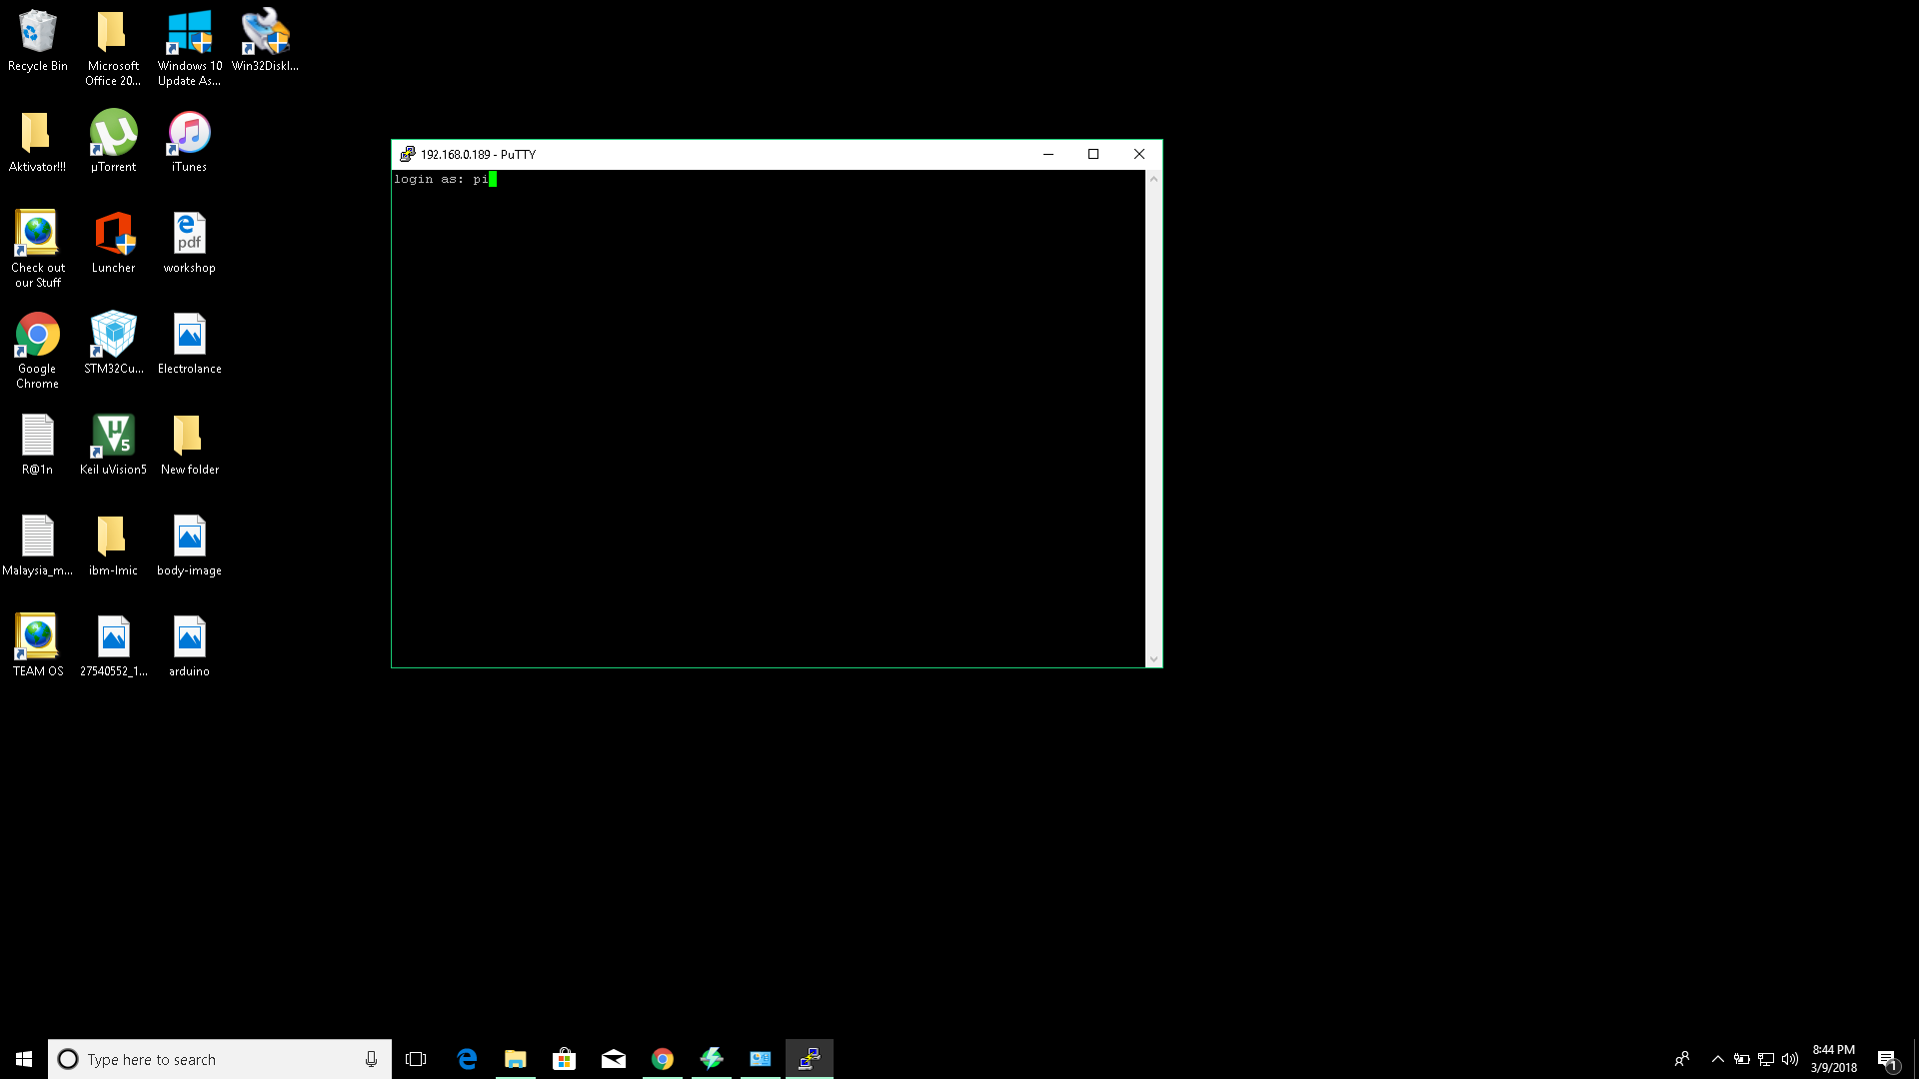
11. Click Yes
13. <password> Type : raspberry.
Note : press enter once entered the password.
12. It would prompt for <username> Type : pi

Slide 32
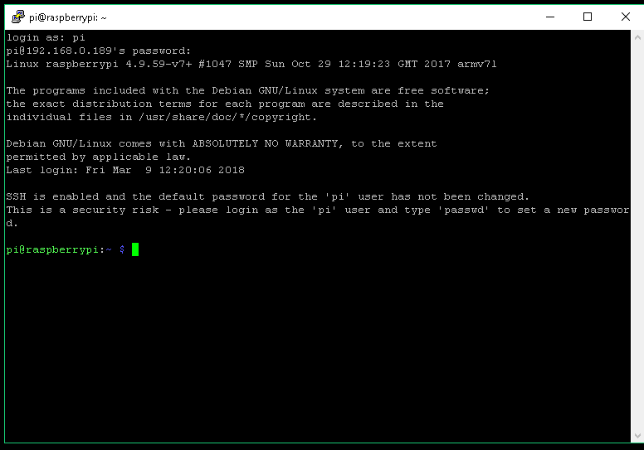
Voila !!, You have successfully remote access to you pi’s terminal

Slide 33
Show me some gui screen
1. Run the command <vncserver -randr=800x600> on the terminal, Copy the ip address.
2. Complete install the vncviewer on your laptop.
3. Run the vncViewer.

Slide 34
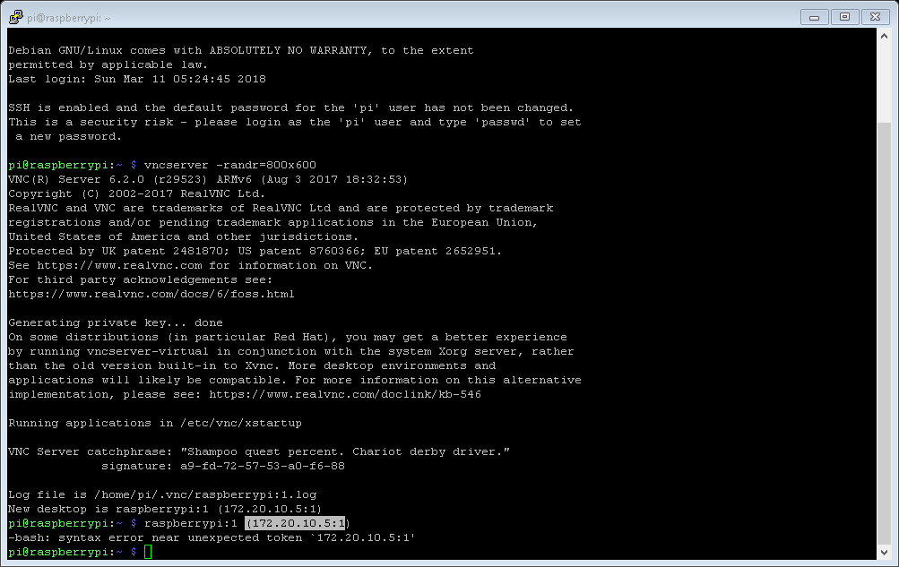

Slide 35
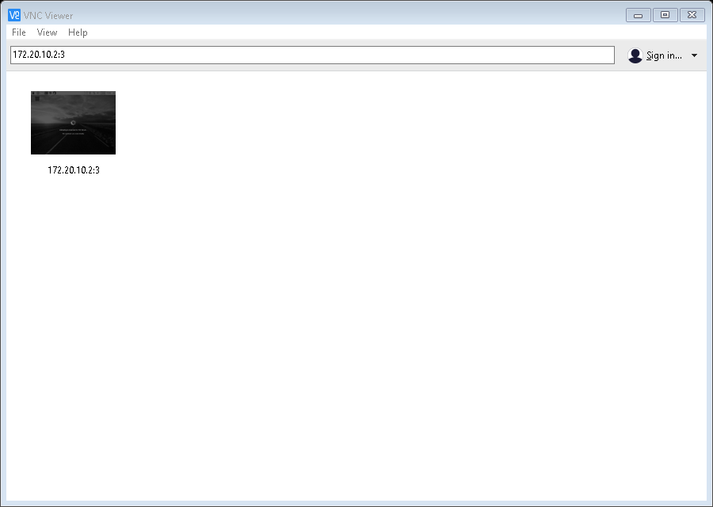

Slide 36
Q&A Session
THE END.

